Slide 1
OOP152 – OBJECT-ORIENTED PROGRAMMING
2024

Slide 2
Overview of imperative concepts in Java

Slide 3
BASICS OF JAVA PROGRAMMING
OUTCOMES
Variables and Operators
Input and Output
Void Methods

Slide 4
Input and output

Slide 5
Input and output
OUTLINE
Input and Output
The System class
The Scanner class
The Program Structure
Inches to Centimetres
Literals and Constants
Centimetres and Inches
Modulus Operator
The Scanner bug

Slide 6
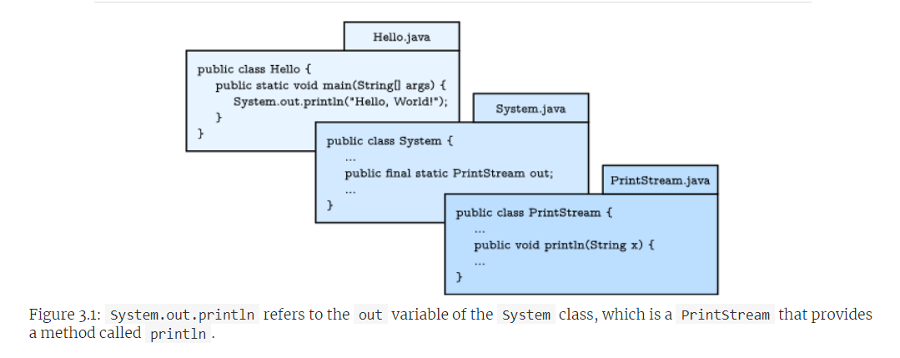
Input and output
Understanding System.out.println:
System Class:

Slide 7
Input and output
Understanding System.out.println:
System Class:
Provides methods related to the system/environment where programs run.
Includes System.out, a special value for displaying output.

Slide 8
Input and output
Understanding System.out.println:
Using System.out.println:
Example: System.out.println(System.out);
Output: java.io.PrintStream@5e91993f // differ based on machine (computer)
Package:
A collection of related classes.
java.io contains classes for input and output (I/O).

Slide 9
Input and output
Understanding System.out.println:
Memory Address:
The address after “@” (e.g., 5e91993f) is the location in memory.
Varies between different computers and runs.
Java Library:
System defined in System.java.
PrintStream defined in PrintStream.java.
Part of the extensive Java library classes available for use. See figure 3.1.

Slide 10
Input and output
The Scanner Class:
System.in and InputStream
Special value System.in is an InputStream.
Provides methods for reading input from the keyboard.
Methods are not easy to use directly.

Slide 11
Input and output
The Scanner Class:
Scanner Class
Part of java.util package.
Provides methods for inputting words, numbers, and other data.
java.util contains utility classes.

Slide 12
Input and output
The Scanner Class:
Importing Scanner
Import statement: import java.util.Scanner;
Tells the compiler to use Scanner from java.util.
Prevents ambiguity if there are other classes named Scanner.
Creating a Scanner
Declare and create Scanner: Scanner in = new Scanner(System.in);
in is a Scanner variable that takes input from System.in.

Slide 13
Input and output
The Scanner Class:
Using nextLine Method
Reads a line of input from the keyboard.
Returns a String.

Slide 14
Input and output
The Scanner Class:
Using nextLine Method
Example:
Scanner in = new Scanner(System.in);
System.out.println("Enter first line:");
String line1 = in.nextLine();
System.out.println("Enter second line:");
String line2 = in.nextLine();
System.out.println("First line: " + line1);
System.out.println("Second line: " + line2);
in.close();

Slide 15
Input and output
The Scanner Class:
Closing the Scanner
Always close the Scanner resource to prevent resource leaks.
Use in.close(); after finishing input operations.

Slide 16
Input and output
The Scanner Class:
Import Statements and Packages
Omitting the import statement for Scanner results in a compiler error: “cannot find symbol”.
The compiler doesn't recognize Scanner without an import statement.
System class can be used without importing it.
System belongs to the java.lang package, imported automatically.
java.lang package includes fundamental classes for Java.

Slide 17
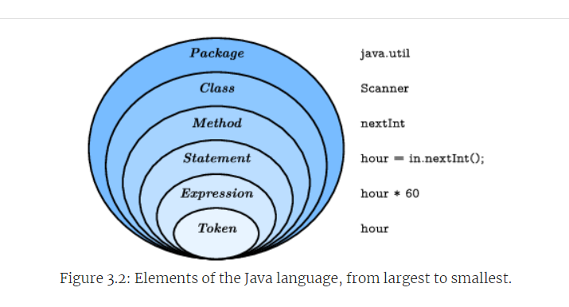
Input and output
Program structure:
Java Organisational Unit

Slide 18
Input and output
Program structure:
Java Organisational Unit
Packages
Collections of classes.
Classes
Define methods.
Methods
Contain statements.
Statements
May include expressions.

Slide 19
Input and output
Program structure:
Java Organisational Unit
Expressions
Made up of tokens.
Tokens
Basic elements of a program.
Include numbers, variable names, operators, keywords.
Punctuation such as parentheses, braces, and semicolons.

Slide 20
Input and output
Inches to centimetres:
Introduction to the Program:
Useful for converting English units to metric units, such as inches to centimetres.
Program Setup:
Declare variables for the measurement:
int inch; //for storing inch values.
double cm; //for the centimetre result.
Create a Scanner object to read input:
Scanner in = new Scanner(System.in);.

Slide 21
Input and output
Inches to centimetres:
User Input:
Prompt the user for the number of inches:
Use System.out.print("How many inches? "); to keep cursor on the same line.
Read and store the input using:
inch = in.nextInt();

Slide 22
Input and output
Inches to centimetres:
Conversion Process:
Convert inches to centimetres by multiplying by 2.54 (the conversion factor).
cm = inch * 2.54;
Display the Result:
Output the conversion to the user:
System.out.print(inch + " in = ");
System.out.println(cm + " cm");

Slide 23
Input and output
Literals and constants:
Understanding Literals and Magic Numbers
A value appearing directly in the program is called a literal, e.g., 2.54.
Using literals like 2.54 directly in expressions can make the code hard to read and maintain.
Issues with Magic Numbers
Magic numbers appear without explanation and can be confusing.
Repeated use of the same unexplained number makes code maintenance difficult.

Slide 24
Input and output
Literals and constants:
Best Practice:
Using Descriptive Variable Names
Assign magic numbers to variables with meaningful names to enhance readability.
Example:
double cmPerInch = 2.54;
cm = inch * cmPerInch;

Slide 25
Input and output
Literals and constants:
Final Keyword and Constants
Use the final keyword to ensure a variable does not change once initialized.
Example:
final double CM_PER_INCH = 2.54;
Naming Conventions for Constants
Constants are typically named in all uppercase with underscores between words.

Slide 26
Input and output
Formatting output:
Output Precision: When printing a double, Java might display up to 16 decimal places, e.g., 1.3333333333333333 for 4.0 / 3.0.
Using printf for Formatting:
The printf method allows more control over the format, where "f" stands for "formatted".
Example: System.out.printf("Four thirds = %.3f", 4.0 / 3.0); results in Four thirds = 1.333.
The format string specifies the output display, combining text and format specifiers that start with a percent sign.

Slide 27
Input and output
Formatting output:
Format Specifiers:
%.3f displays a floating-point number rounded to three decimal places.
Multiple values can be formatted in one statement, e.g., int inch = 100; double cm = inch * CM_PER_INCH; System.out.printf("%d in = %f cm\n", inch, cm); displays 100 in = 254.000000 cm.
Control Over Newlines:
Like print, printf does not automatically append a newline, so format strings often end with \n.

Slide 28
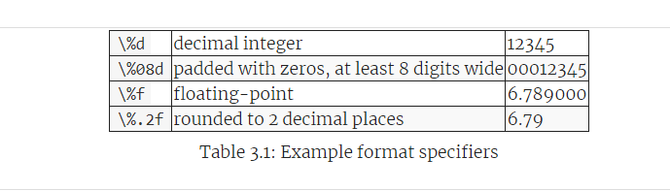
Input and output
Formatting output:
Specifiers for Different Types:

Slide 29
Input and output
Centimetres to inches:
Introduction to Type Casting
Conversion from floating-point to integer causes errors when not handled properly.
Example error when assigning a floating-point result to an integer variable.
Using Type Casting
Type casting converts a value from one type to another.
Syntax: (type_name) value—e.g., (int) pi converts the double value pi to int.
Conversion rounds toward zero, discarding the fractional part.

Slide 30
Input and output
Centimetres to inches:
Precedence in Operations
Type casting has higher precedence over arithmetic operations.
Example: double x = (int) pi * 20.0; results in 60.0 due to precedence.
Practical Application
Converting centimetres to inches: inch = (int) (cm / CM_PER_INCH);
Ensures division is performed before converting the result to an integer.
The conversion ignores any decimal part, effectively rounding down.

Slide 31
Input and output
Centimetres to inches:
Outputting the Result
Uses printf to format and display the conversion result.
Example: System.out.printf("%f cm = %d in\n", cent, inch); shows the conversion with formatting.

Slide 32
Input and output
Modulus operator:
Introduction to Operators:
Division operator (/) for computing the quotient.
Modulus operator (%) for computing the remainder.

Slide 33
Input and output
Modulus operator:
Example: Converting Inches to Feet and Inches:
Given: 76 inches.
Objective: Convert to feet and inches.
Process:
Quotient = 76 / 12 yields 6 feet.
Remainder = 76 % 12 yields 4 inches.
Result: 76 inches is equivalent to 6 feet 4 inches.

Slide 34
Input and output
Modulus operator:
Example: Converting Inches to Feet and Inches:
Given: 76 inches.
Objective: Convert to feet and inches.
Process:
Quotient = 76 / 12 yields 6 feet.
Remainder = 76 % 12 yields 4 inches.
Result: 76 inches is equivalent to 6 feet 4 inches.

Slide 35
Input and output
Modulus operator:
Pronunciation and Visualization:
76 % 12 is read as "76 mod 12".
Visualize % as a rotated division sign (÷).

Slide 36
Input and output
Modulus operator:
Utility of the Modulus Operator:
Divisibility Test:
Example:
To check if x is divisible by y,
if x % y equals 0, then x is divisible by y.
Digit Extraction:
Rightmost digit: x % 10.
Last two digits: x % 100.
Extensively used in encryption algorithms.

Slide 37
Input and output
Modulus operator:
Examples for Practice:
Calculate Feet and Inches: Convert 123 inches to feet and inches.
Feet: 123 / 12
Inches: 123 % 12
Divisibility Test:
Check if 1024 is divisible by 16.
1024 % 16 should result in 0.
Extract Digits:
Find the last two digits of 5678.
5678 % 100 yields 78.

Slide 38
Input and output
Putting it all together:
double cm;
int feet, inches, remainder;
final double CM_PER_INCH = 2.54;
final int IN_PER_FOOT = 12;
Scanner in = new Scanner(System.in);
// prompt the user and get the value
System.out.print("Exactly how many cm? ");
cm = in.nextDouble();

Slide 39
Input and output
Putting it all together:
// convert and output the result
inches = (int) (cm / CM_PER_INCH);
feet = inches / IN_PER_FOOT;
remainder = inches % IN_PER_FOOT;
System.out.printf("%.2f cm = %d ft, %d in\n", cm, feet, remainder);
in.Close();

Slide 40
Input and output
The Scanner bug:
Reading a string after an int or Double could be problematic. Techniques to overcome below:
System.out.print("What is your age? ");
age = in.nextInt();
in.nextLine(); // read the newline
System.out.print("What is your name? ");
name = in.nextLine();
System.out.printf("Hello %s, age %d\n", name, age);

Slide 41
Exercises

Slide 42

Input and output
Exercises:
Write a program that converts a temperature from Celsius to Fahrenheit. It should (1) prompt the user for input, (2) read a double value from the keyboard, (3) calculate the result, and (4) format the output to one decimal place. For example, it should display "24.0 C = 75.2 F".
Here is the formula. Be careful not to use integer division!

Slide 43



